Slide 1
Introduction to Data Mining
Courtecy of Srinivasan Parthasarathy
© Prentice Hall
1

Slide 2
Outline
Define data mining
Data mining versus databases
Basic data mining tasks
Data mining development
Data mining issues
© Prentice Hall

Slide 3
Introduction
Data is produced at a phenomenal rate
Our ability to store has grown
Users expect more sophisticated information
How?
UNCOVER HIDDEN INFORMATION
DATA MINING
© Prentice Hall

Slide 4
Data mining
Objective - Fit data to a model
Potential result - Higher-level meta information that may not be obvious when looking at raw data
Similar terms:
  Exploratory data analysis
  Data driven discovery
  Deductive learning
© Prentice Hall

Slide 5
Data Mining Algorithm
Objective: Fit Data to a Model
  Descriptive
  Predictive
Preferential Questions
  Which technique to choose?
    ARM/Classification/Clustering
    Answer: Depends on what you want to do with data?
  Search Strategy – Technique to search the data
    Interface? Query Language?
    Efficiency
© Prentice Hall

Slide 6
Database processing vs. Data mining processing
Query
  Well defined
  SQL
Query
  Poorly defined
  No precise query language
Output
  Precise
  Subset of database
Output
  Fuzzy
  Not a subset of database
© Prentice Hall

Slide 7
Query examples
Database
Data Mining
Find all credit applicants with last name of Smith.
  Identify customers who have purchased more than $10,000 in the last month.
        Find all customers who have purchased milk
  Find all credit applicants who are poor credit risks. (Classification)
        Identify customers with similar buying habits. (Clustering)
Find all items which are frequently purchased with milk. (Association rules)
© Prentice Hall

Slide 8
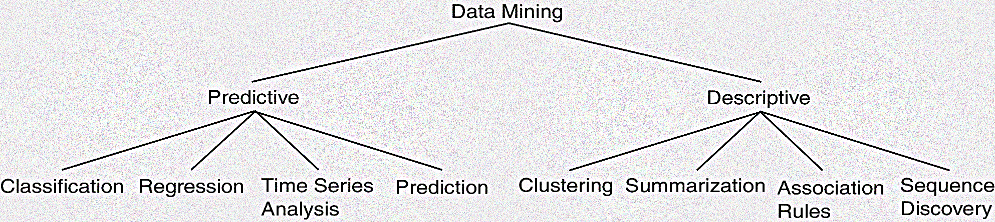
Data mining models and tasks
© Prentice Hall

Slide 9
Basic data mining tasks
Classification maps data into predefined groups or classes
  Supervised learning
  Pattern recognition
  Prediction
Regression is used to map a data item to a real valued prediction variable.
Clustering groups similar data together into clusters.
  Unsupervised learning
  Segmentation
  Partitioning
© Prentice Hall

Slide 10
Basic data mining tasks
Summarization maps data into subsets with associated simple descriptions.
  Characterization
  Generalization
Link Analysis uncovers relationships among data.
  Affinity Analysis
  Association Rules
  Sequential Analysis determines sequential patterns.
© Prentice Hall

Slide 11
Data mining versus KDD
Knowledge Discovery in Databases (KDD)
The process of finding useful information and patterns in data.
Data Mining
The use of algorithms to extract the information and patterns derived by the KDD process.
© Prentice Hall

Slide 12
Data mining - KDD process
Knowledge
  Data mining – the core
  of the knowledge
  discovery process
Pattern Evaluation
Data Mining
Task-relevant data
Data Warehouse
Selection
Data Cleaning
Data Integration
Databases
Data Mining: Concepts and Techniques

Slide 13
KDD process example: Web Log
Selection:
  Select log data (dates and locations) to use
Preprocessing:
  Remove identifying URLs
  Remove error logs
Transformation:
  Sessionize (sort and group)
Data Mining:
  Identify and count patterns
  Construct data structure
Interpretation/Evaluation:
  Identify and display frequently accessed sequences.
Potential User Applications:
  Cache prediction
  Personalization
© Prentice Hall

Slide 14
Data Mining Development
Relational Data Model
SQL
Association Rule Algorithms
Data Warehousing
Scalability Techniques
Similarity Measures
Hierarchical Clustering
IR Systems
Imprecise Queries
Textual Data
Web Search Engines
Bayes Theorem
Regression Analysis
EM Algorithm
K-Means Clustering
Time Series Analysis
DATA MINING
Algorithm Design Techniques
Algorithm Analysis
Data Structures
Neural Networks
Decision Tree Algorithms
© Prentice Hall

Slide 15
KDD Issues
Human Interaction
Overfitting
Outliers
Interpretation
Visualization
Large Datasets
High Dimensionality
Multimedia Data
Missing Data
Irrelevant Data
Noisy Data
Changing Data
Integration
Application
© Prentice Hall

Slide 16
To do
Statistical basics (revisited)
  Point Estimation
  Models Based on Summarization
  Bayes Theorem
  Hypothesis Testing
  Regression and Correlation
Similarity measures
© Prentice Hall

Slide 17
Point estimation
Point Estimate
Estimate a population parameter
May be made by calculating the parameter for a sample.
May be used to predict value for missing data.
Example
  R contains 100 employees
  99 have salary information
  Mean salary of these is $ 50,000
  Use $50,000 as value of remaining employee’s salary.
Is this a good idea?
© Prentice Hall

Slide 18
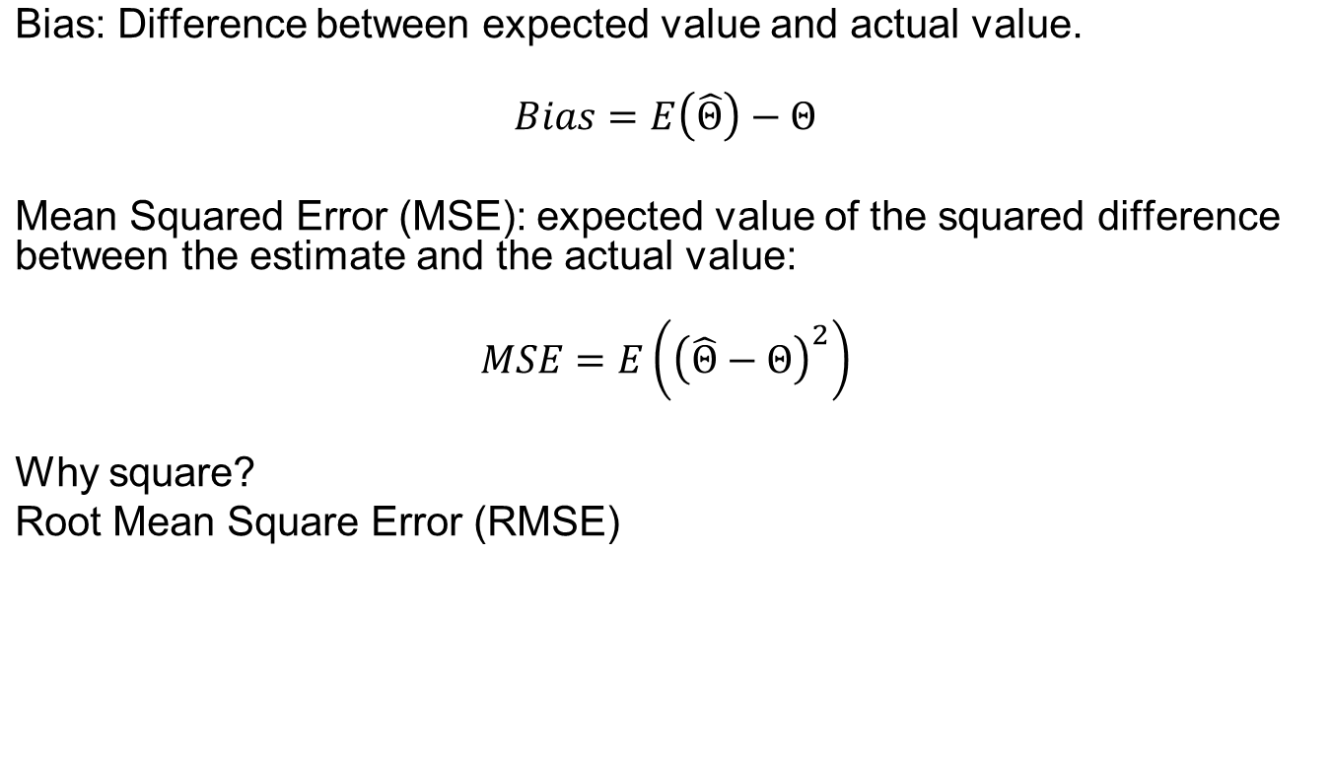
Estimation error
© Prentice Hall

Slide 19
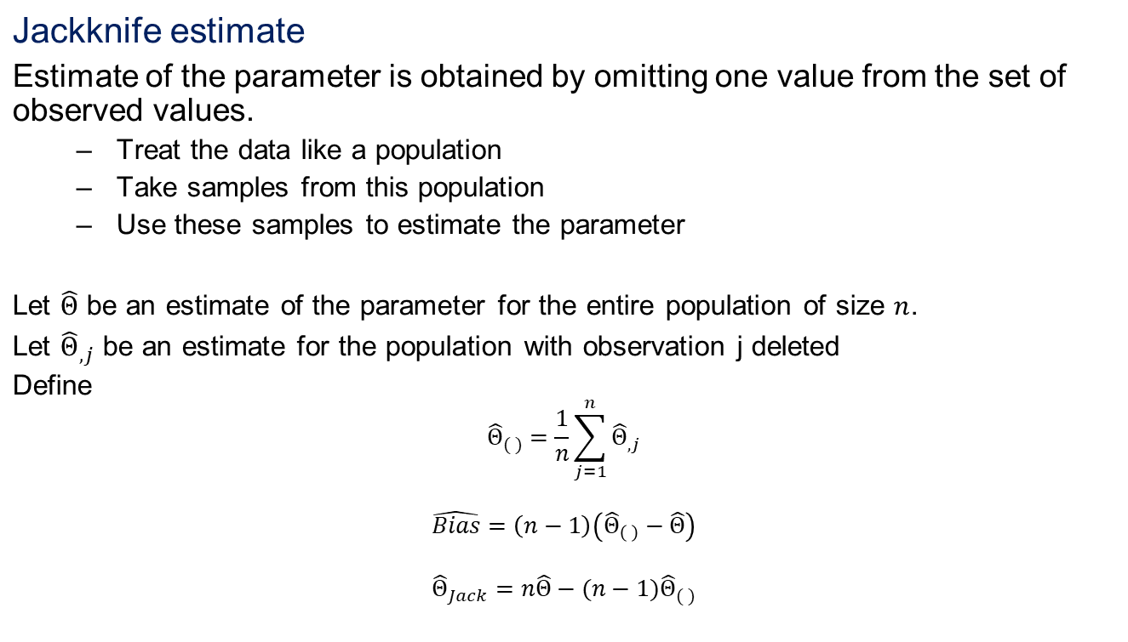
Jackknife estimate
© Prentice Hall

Slide 20
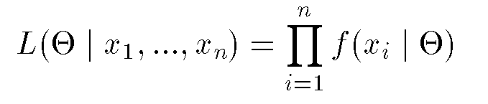
Maximum likelihood estimate (MLE)
Obtain parameter estimates that maximize the probability that the sample data occurs for the specific model.
Joint probability for observing the sample data by multiplying the individual probabilities. Likelihood function defined as,
Maximize L.
© Prentice Hall

Slide 21
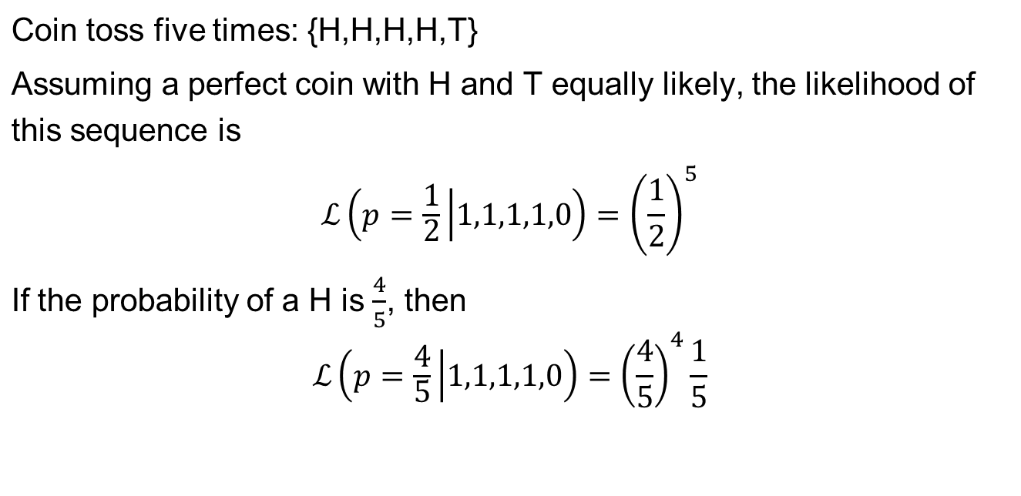
MLE example
© Prentice Hall

Slide 22
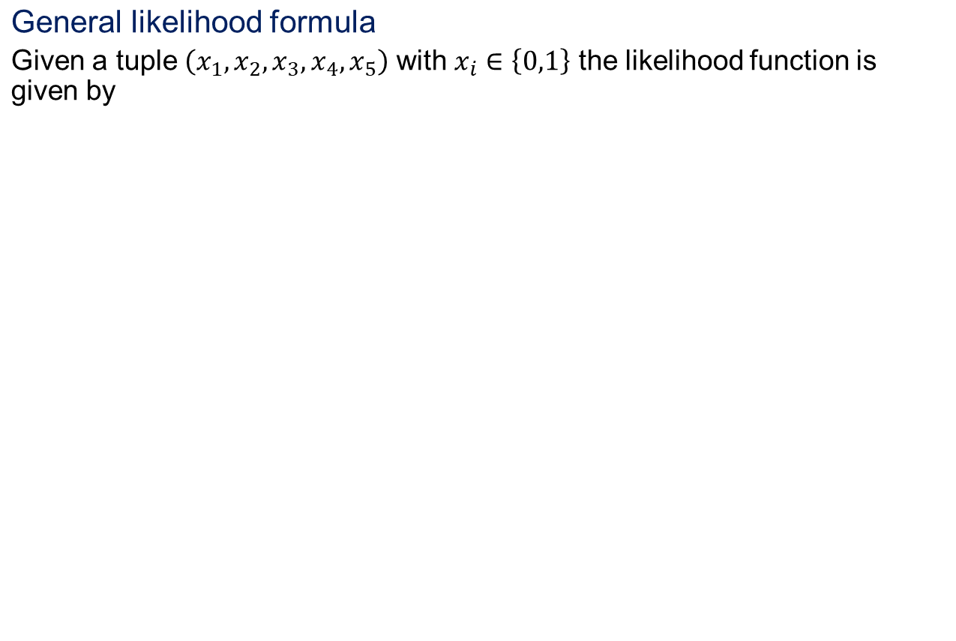
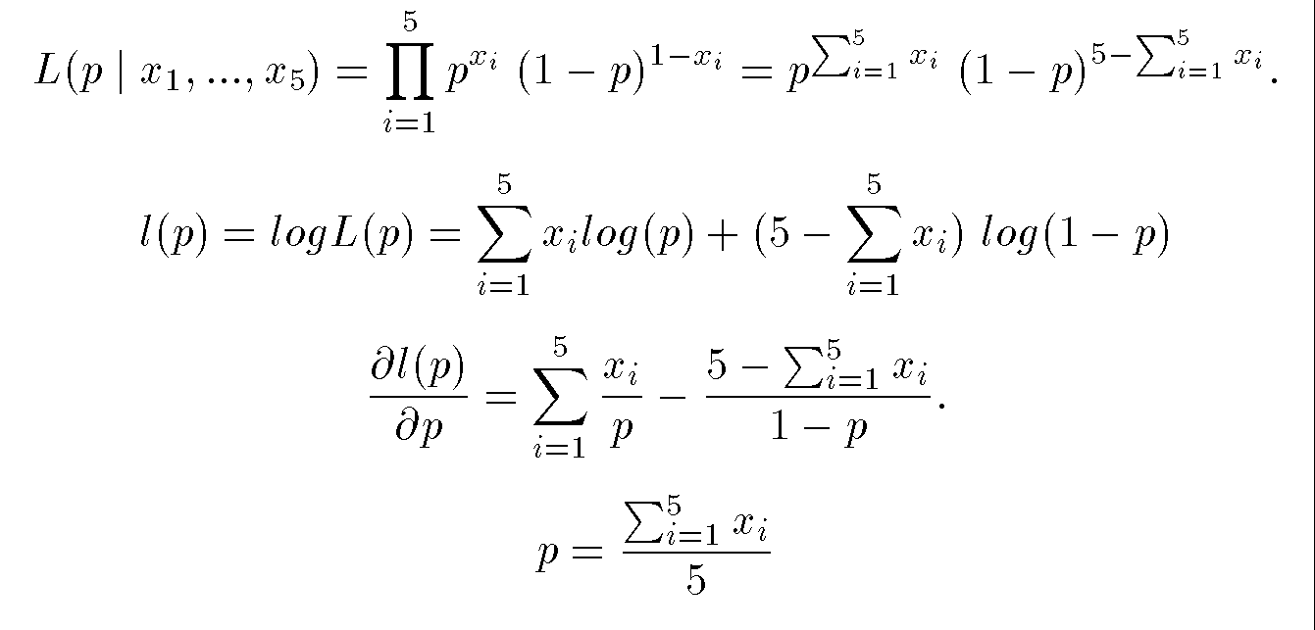
MLE example
© Prentice Hall

Slide 23
Expectation-Maximization (EM)
Solves estimation with incomplete data.
Obtain initial estimates for parameters.
Iteratively use estimates for missing data and continue until convergence.
© Prentice Hall

Slide 24
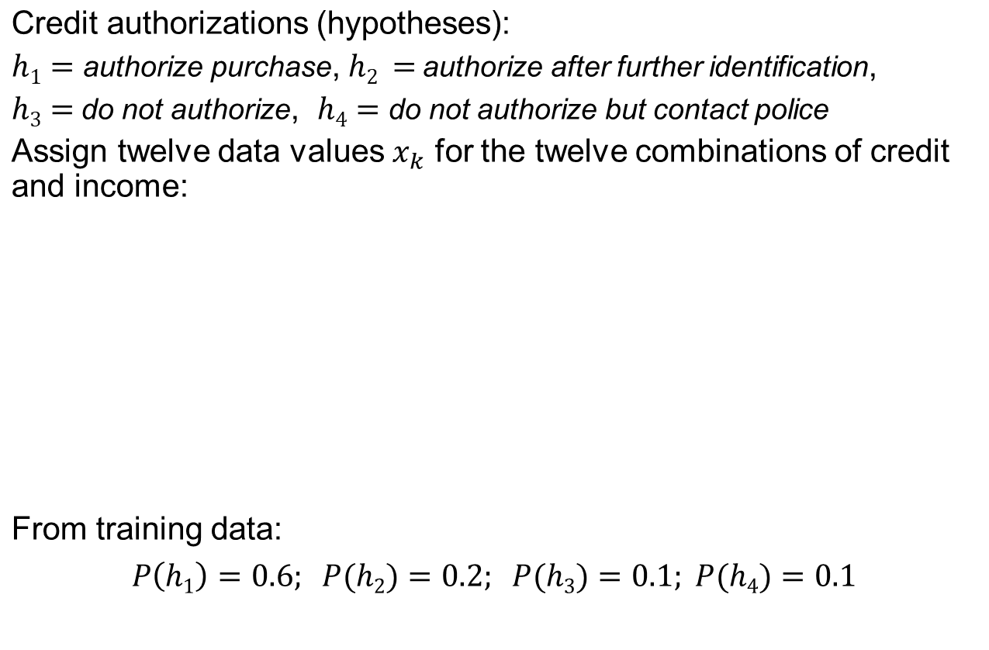
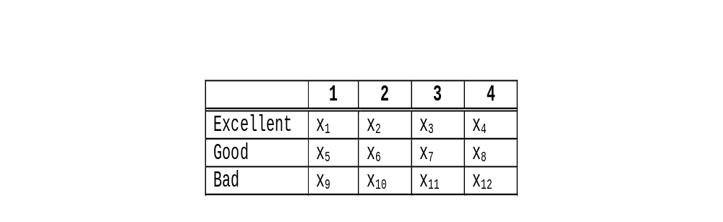
Bayes theorem example
© Prentice Hall

Slide 25
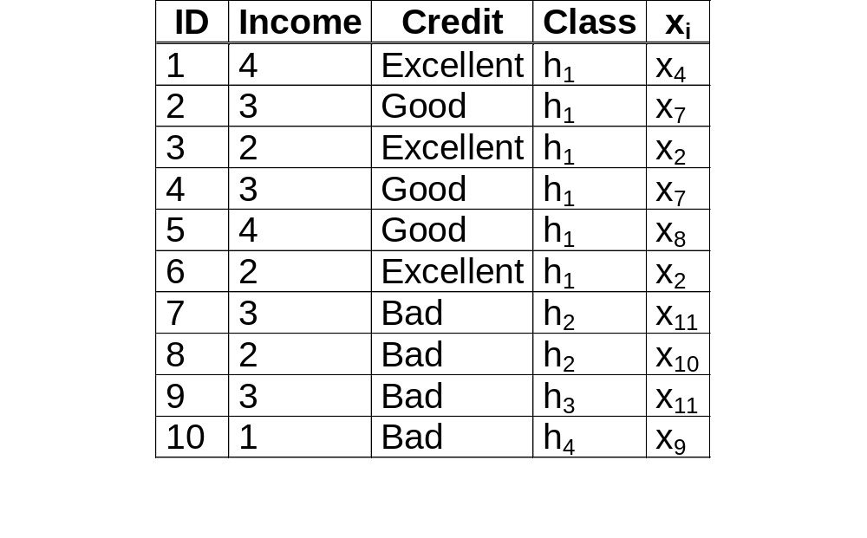
Bayes example
Training Data
© Prentice Hall

Slide 26
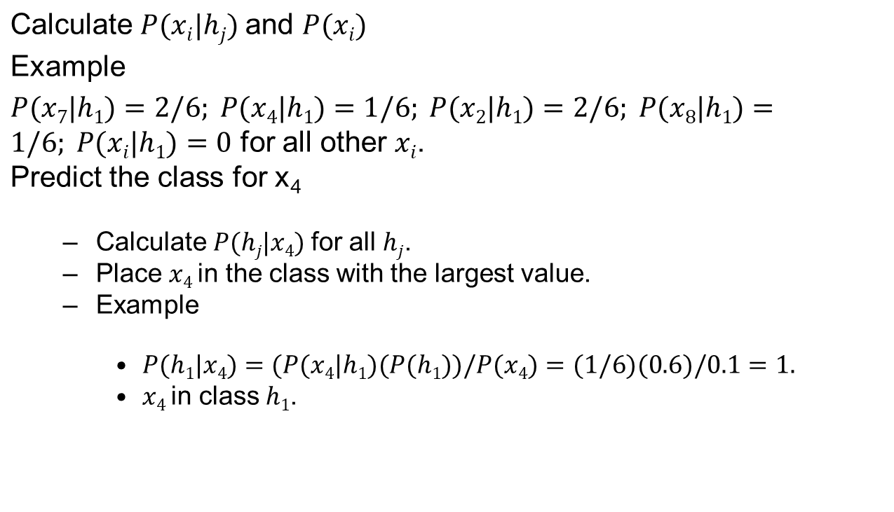
Bayes example
© Prentice Hall

Slide 27
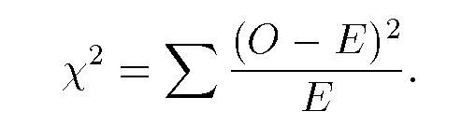
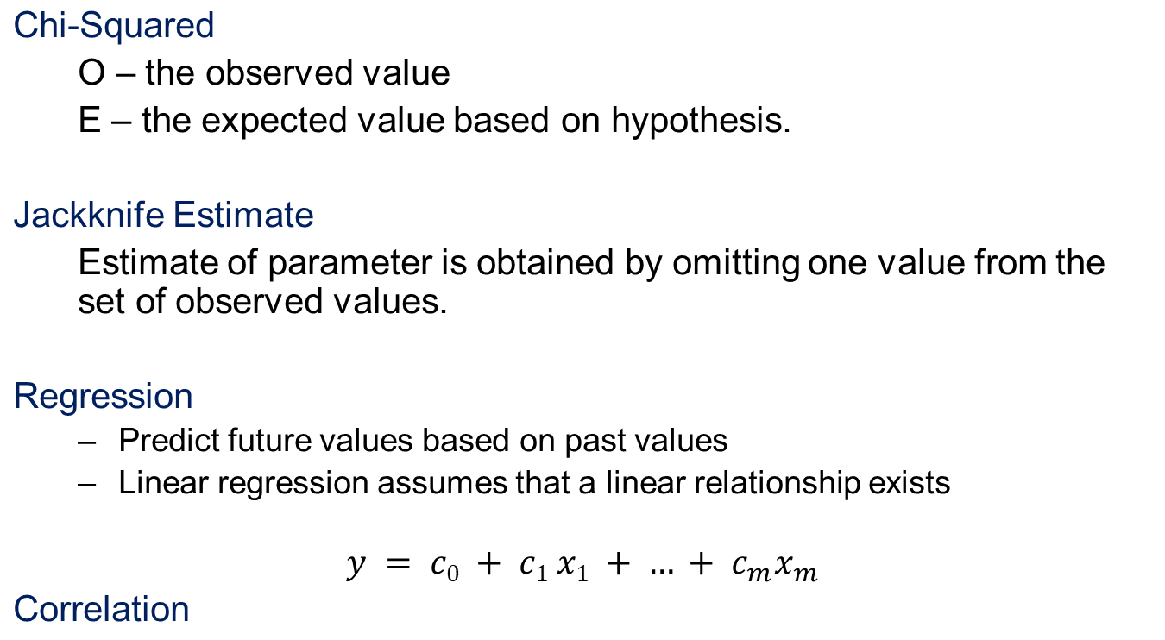
Other statistical measures
© Prentice Hall

Slide 28
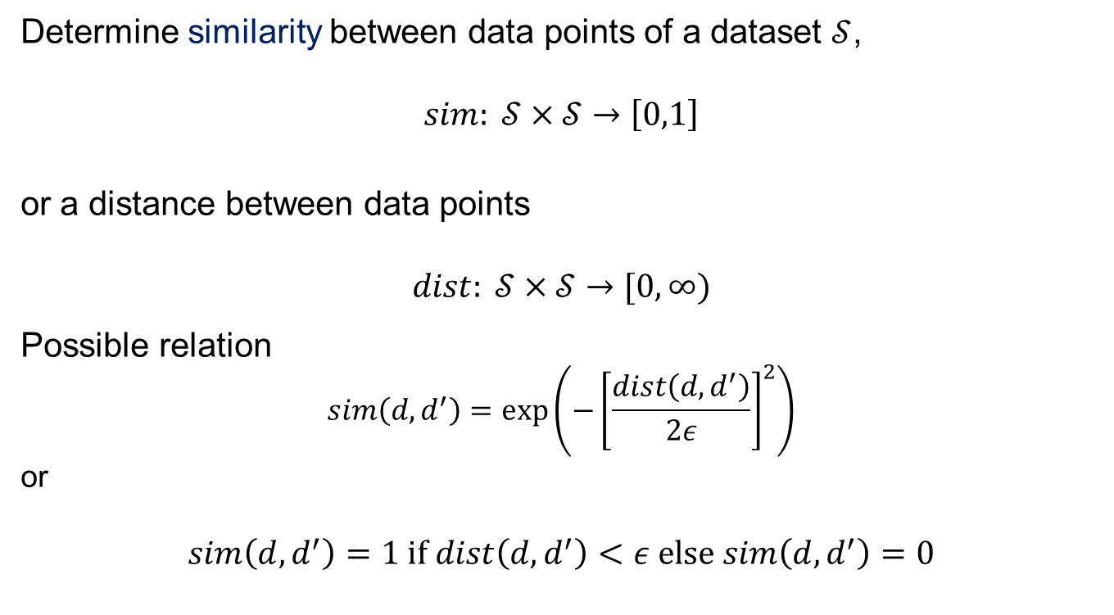
Similarity measures
© Prentice Hall

Slide 29
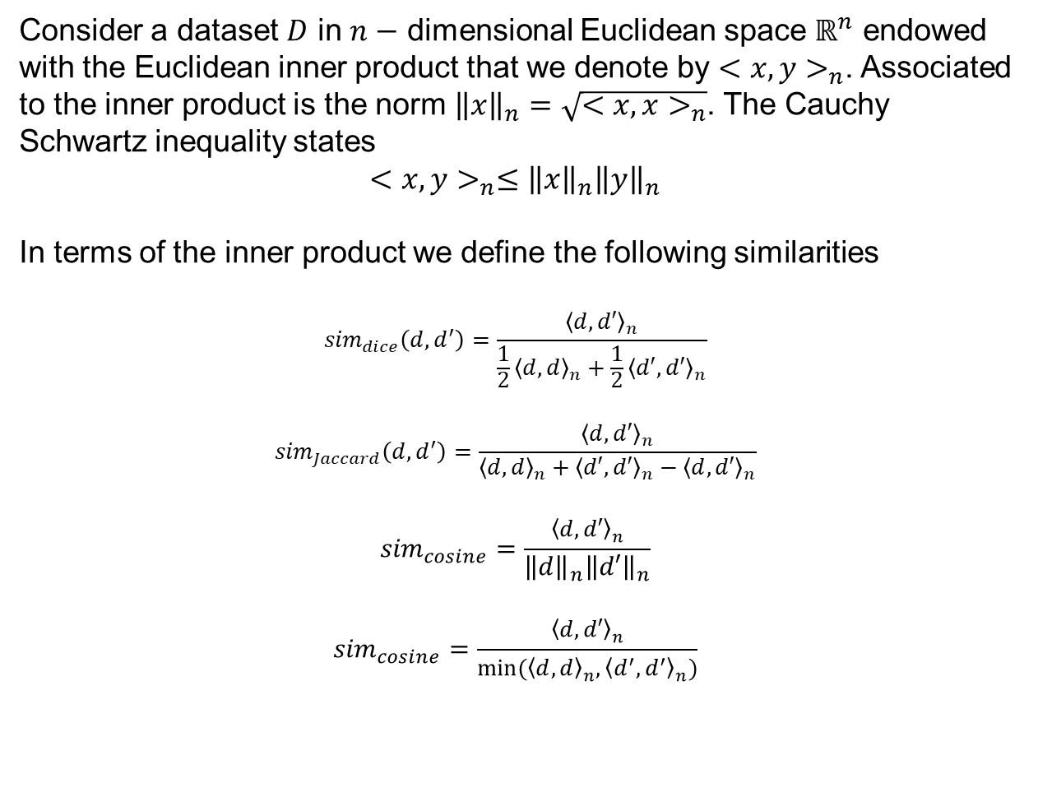
Similarity measures (in Python)
© Prentice Hall

Slide 30
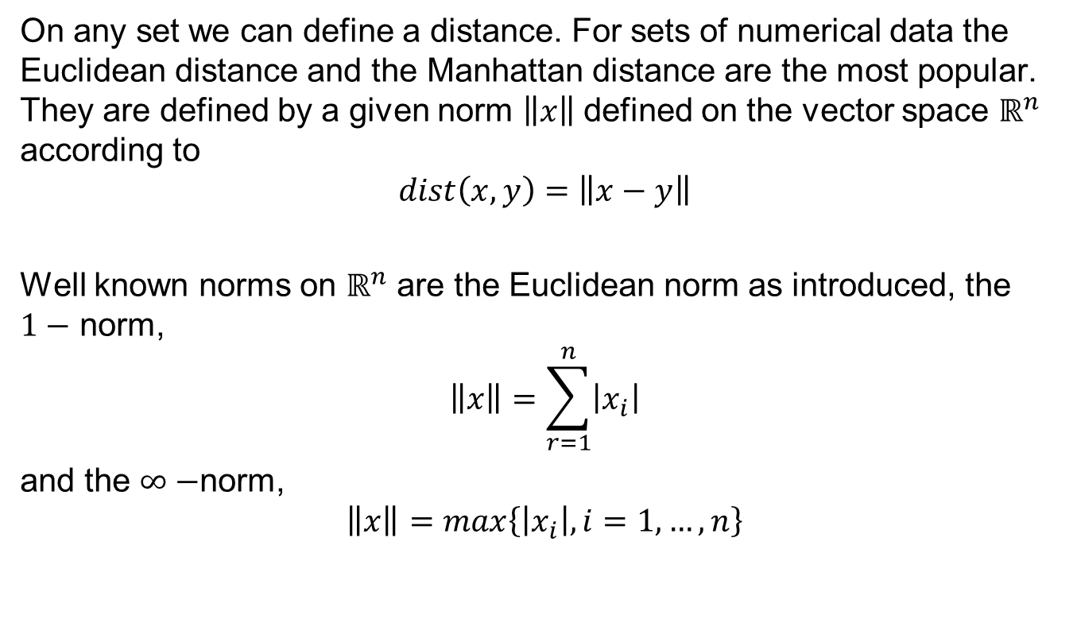
Distance measures
© Prentice Hall

